Slide 1

Florida Discipline Report and the Effects of Covid-19
Nathan Johnson 4/26/23

Slide 2

Outline
Executive Summary
Introduction
Methodology
Results
Conclusion
Appendix

Slide 3
Executive Summary
Summary of methodologies
Data Collection through Florida DOE Website
Data Cleaning and Formatting
Exploratory Data Analysis with Data Visualization
Summary of all results
Exploratory Data Analysis result
Interactive analytics in screenshots

Slide 4
Introduction
Schools across the nation are experiencing a change in the quantity and quality of disciplinary incidences since schools were forced to shut down from Covid. At the end of the 2019-2020 school year and into the 2020-2021 school year, schools were forced to develop and implement a fully online or hybrid model of education. Most schools returned to full time instruction for the 2021-2022 school year, and quickly administrators began to notice a change in the typical disciplinary incidences.
This projects seeks to discover the primary differences in behavior post-Covid of students in Florida and which behavioral incidences contributed the most to a nearly 30% increase post-Covid. By recognizing which specific behaviors are directly correlated and account for such a drastic increase, administrators can begin to implement policies and strategies to combat these behaviors, hopefully developing a more safe, educationally friendly environment for students.

Slide 5

Section 1

Slide 6

Data Collection
The data was downloaded from the Florida Department of Education’s website on discipline.
Florida Discipline Report
I focused mainly on state-wide consolidated discipline incidences from 2010-2019 and then from 2021-2022.
The school years of 2019-2020 and 2020-2021 were omitted from this project due to many schools closing or moving to a hybrid model during those school years in order to avoid skewed data.

Slide 7
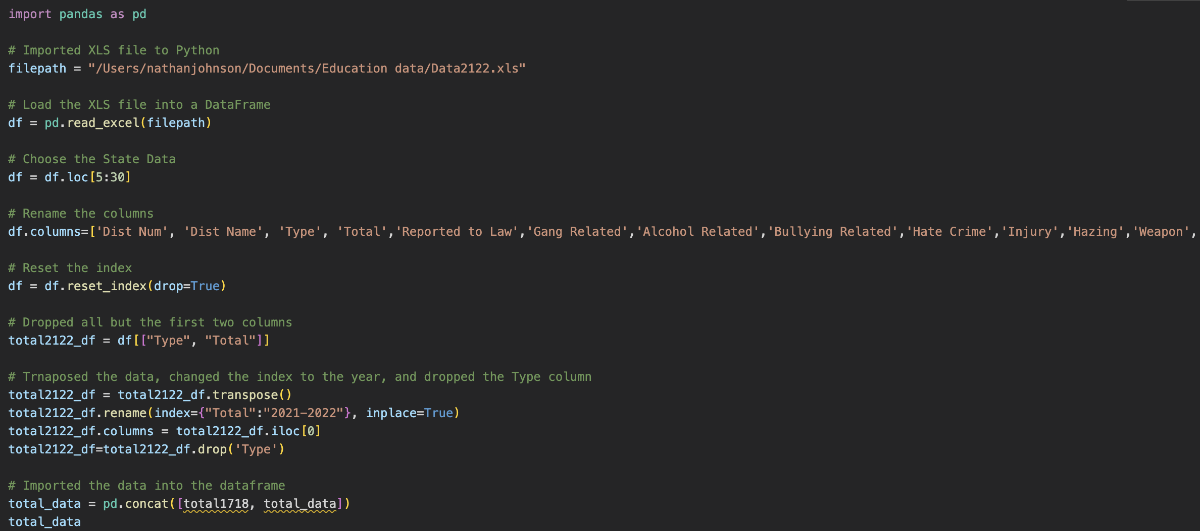
Data Collection – Excel
I imported the data from Excel and compiled the data into a single dataframe.
In order to keep the data consistent by column, I made the following changes:
Renamed “Aggravated Battery” to ”Battery” in 2021-2022.
Created new columns named “Physical Attack”, “Sexual Assault”, and “Hazing” for data years 2010-2014
Removed ”Homicide” from data due to lack of data.

Slide 8
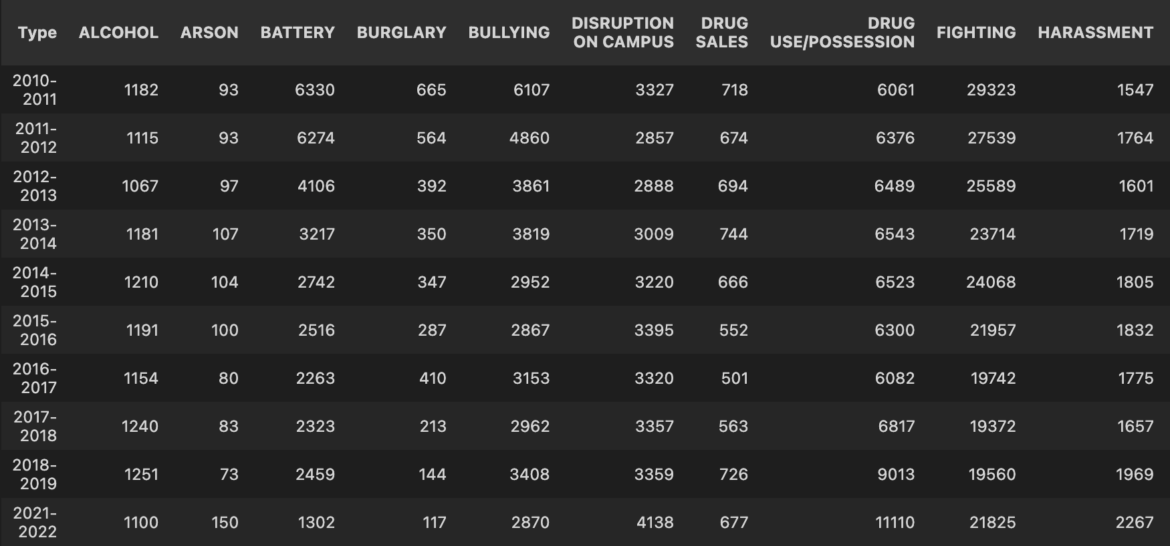
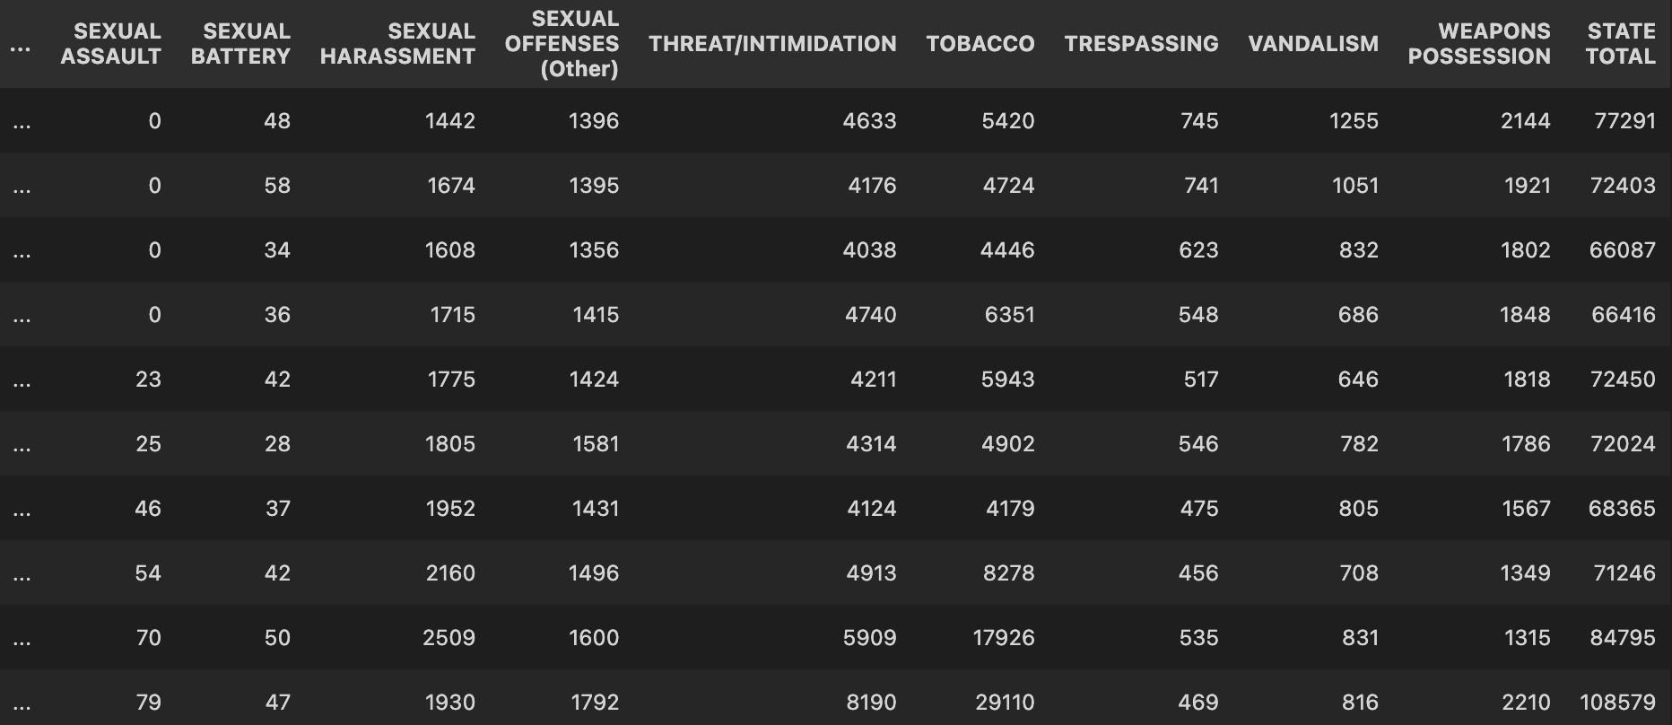
Data Collection – Excel
After importing all of the data, I compiled the data into a single dataframe.

Slide 9
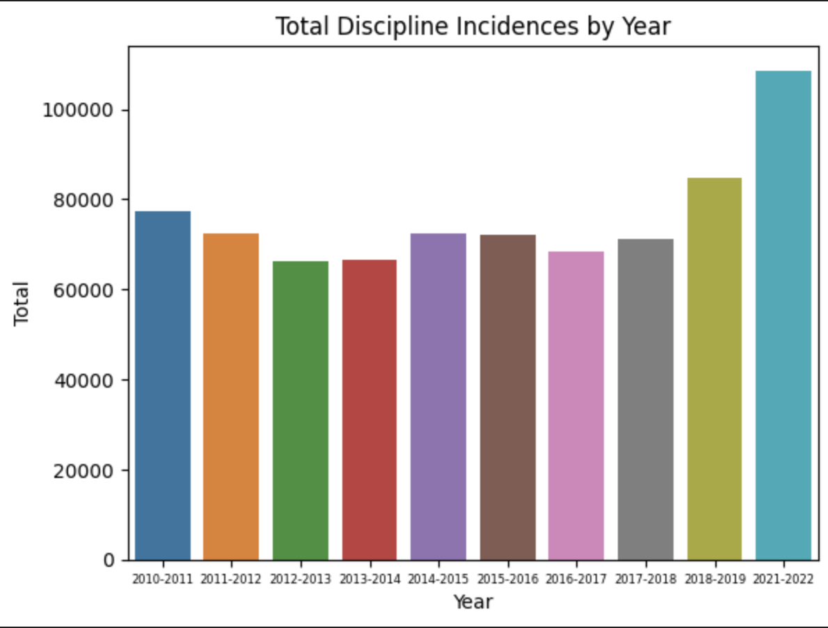
EDA with Data Visualization
Once the data was compiled, I analyzed the data using visualizations.
As we can see, in 2021-2022 we saw nearly a 30% in discipline incidences state-wide.

Slide 10
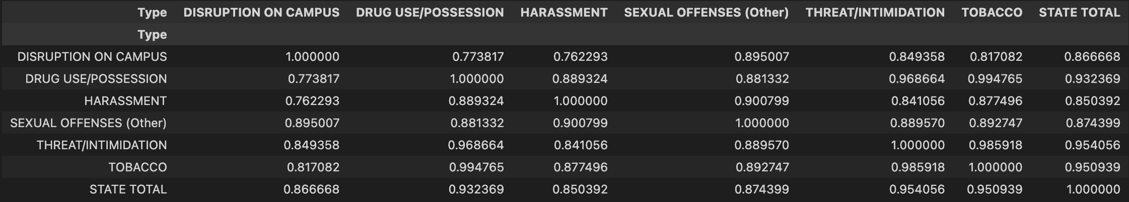
Exploratory Data Analysis
Other methods were used to analyze the relationship between variables, such as correlation. I then analyzed the data values to find relationships.

Slide 11

Section 2

Slide 12
Total Incidences
As shown previously, there was nearly a 30% increase in discipline incidences statewide.

Slide 13
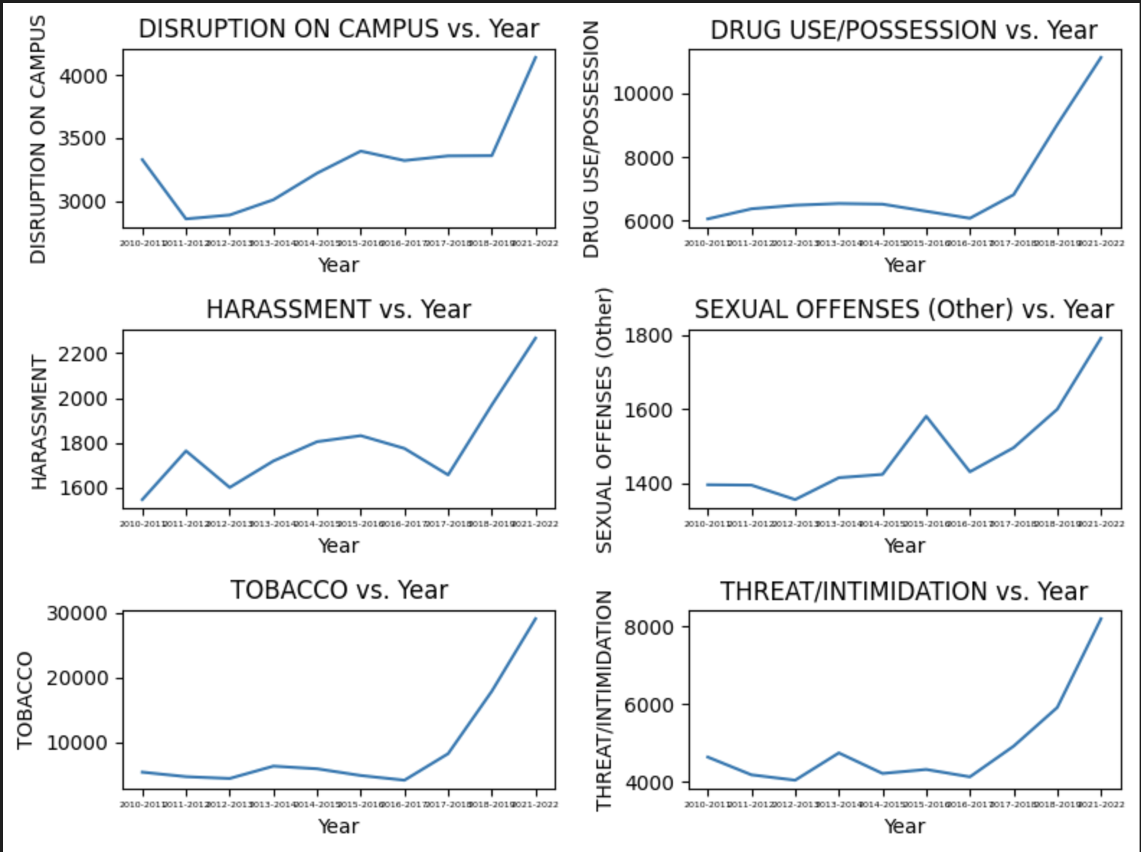
Areas of High Correlation
Looking at correlation, the highest categories were
Disruption on Campus
Drug Use/Possession
Harassment
Sexual Offenses
Threat/Intimidation
Tobacco
These six variables have
R²: 0.936
Adjusted R²: 0.808

Slide 14
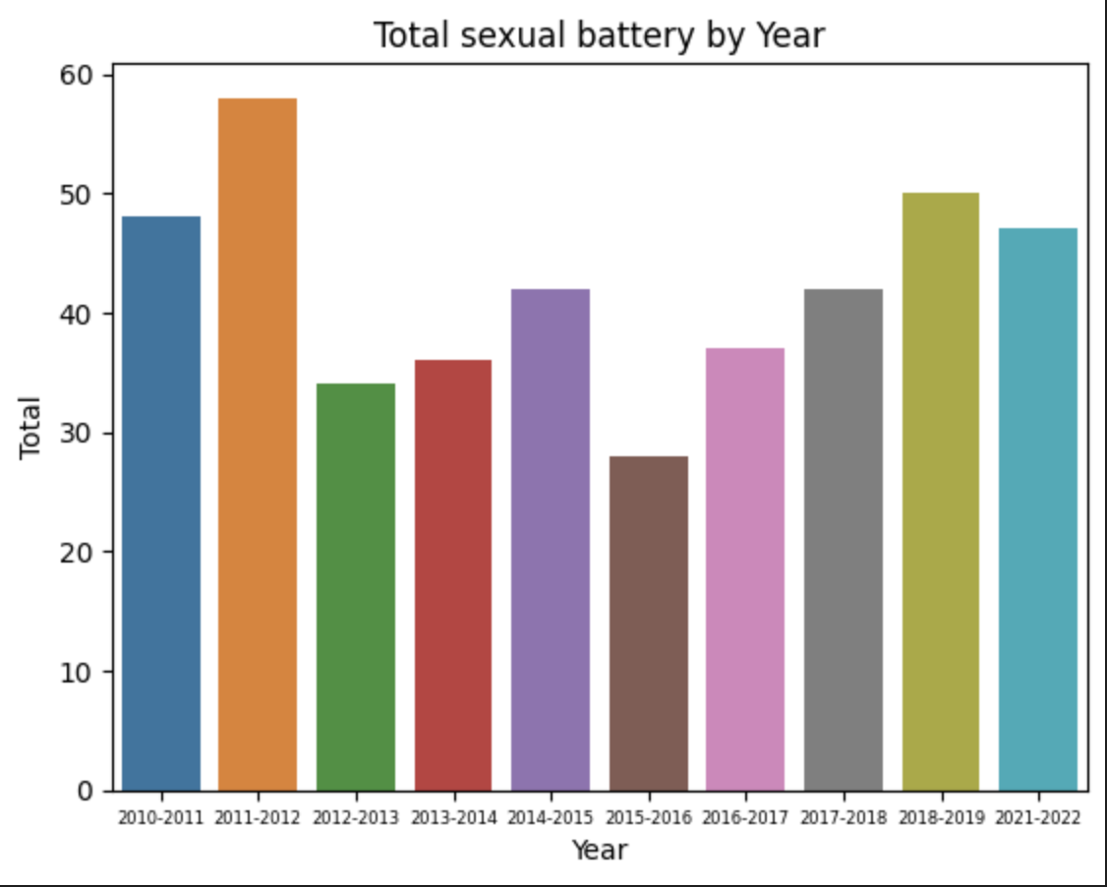
Other Analyses
When using Spearman Rank Correlation analysis, the highest calculated rho and p-values were the same 6 categories but included Sexual Battery. However, visual analysis shows that this is incorrect.

Slide 15
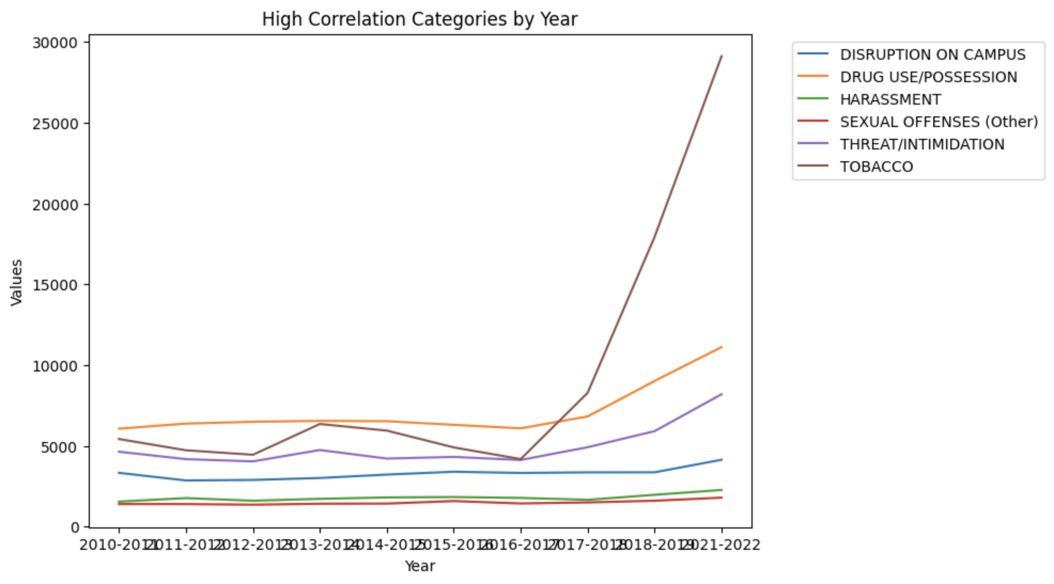
Comparing High Correlation Categories
When comparing these six categories, we notice that Tobacco has the greatest increase.

Slide 16
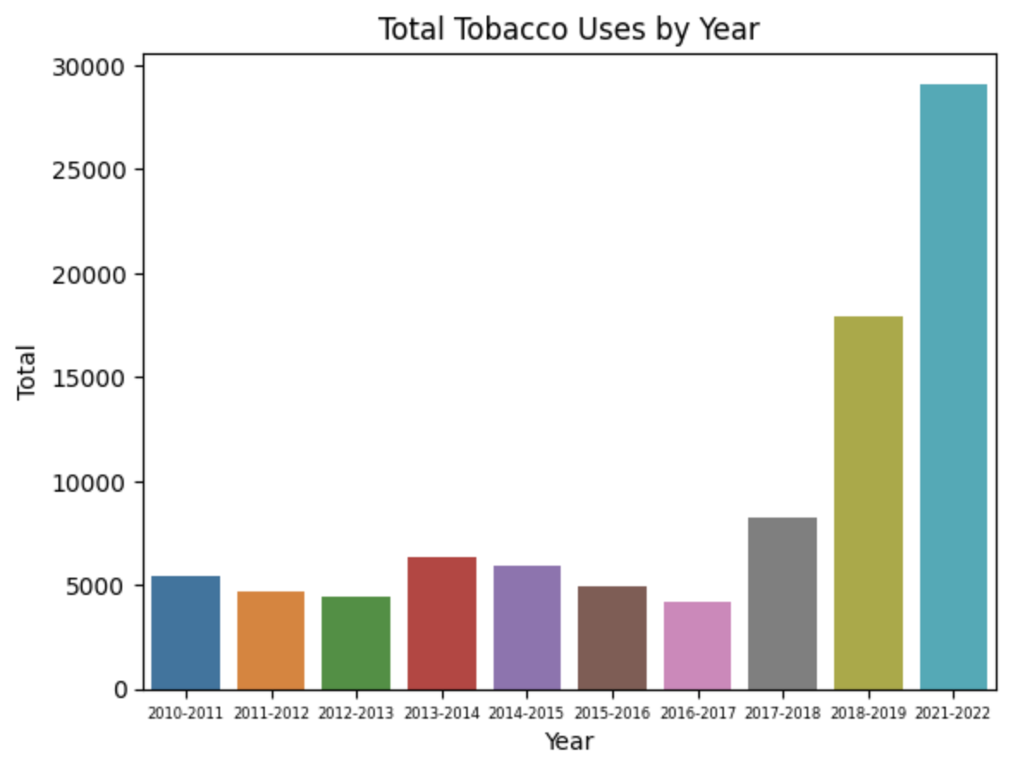
Tobacco
From 2018-2019 to 2021-2022, tobacco incidences increased 62.3%.
From 2017-2018 to 2021-2022, tobacco incidences increased 251%.

Slide 17
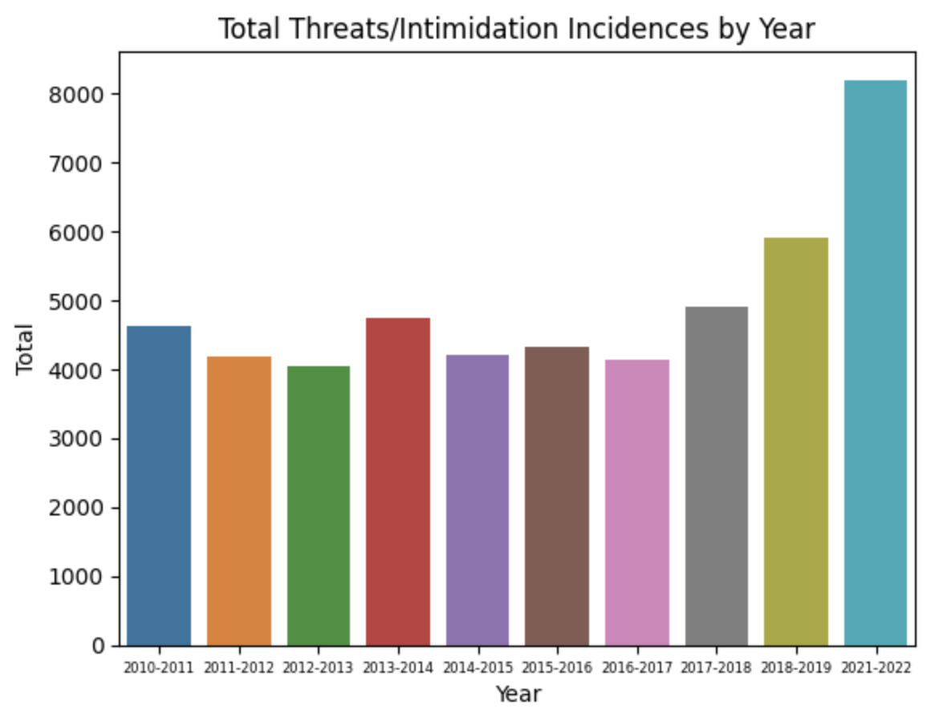
Threats and Reports of Intimidation
Threats and intimidation incidences increased by 38% post the Covid-19 lockdown.
“An incident where there was no physical contact between the offender and victim, but the victim reasonably believed that physical harm could have occurred based on verbal or nonverbal communication by the offender. This includes nonverbal threats and verbal threats of physical harm which are made in person, electronically or through any other means.”

Slide 18
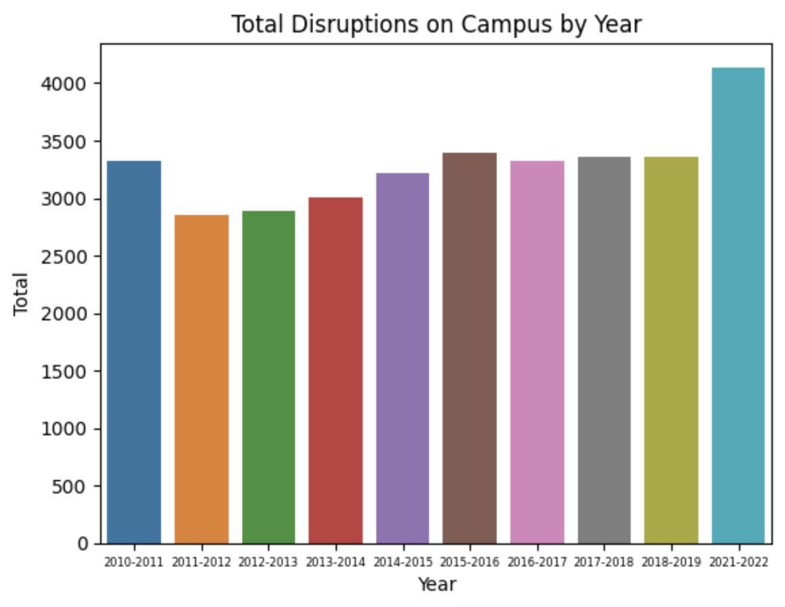
Disruptions on Campus
After years on consistency, post Covid, Disruptions on Campus increased 23%.
Disruptions on Campus is defined as “Disruptive behavior that poses a serious threat to the learning environment, health, safety, or welfare of others. Examples of major disruptions include bomb threats, inciting a riot, or initiating a false fire alarm.”

Slide 19
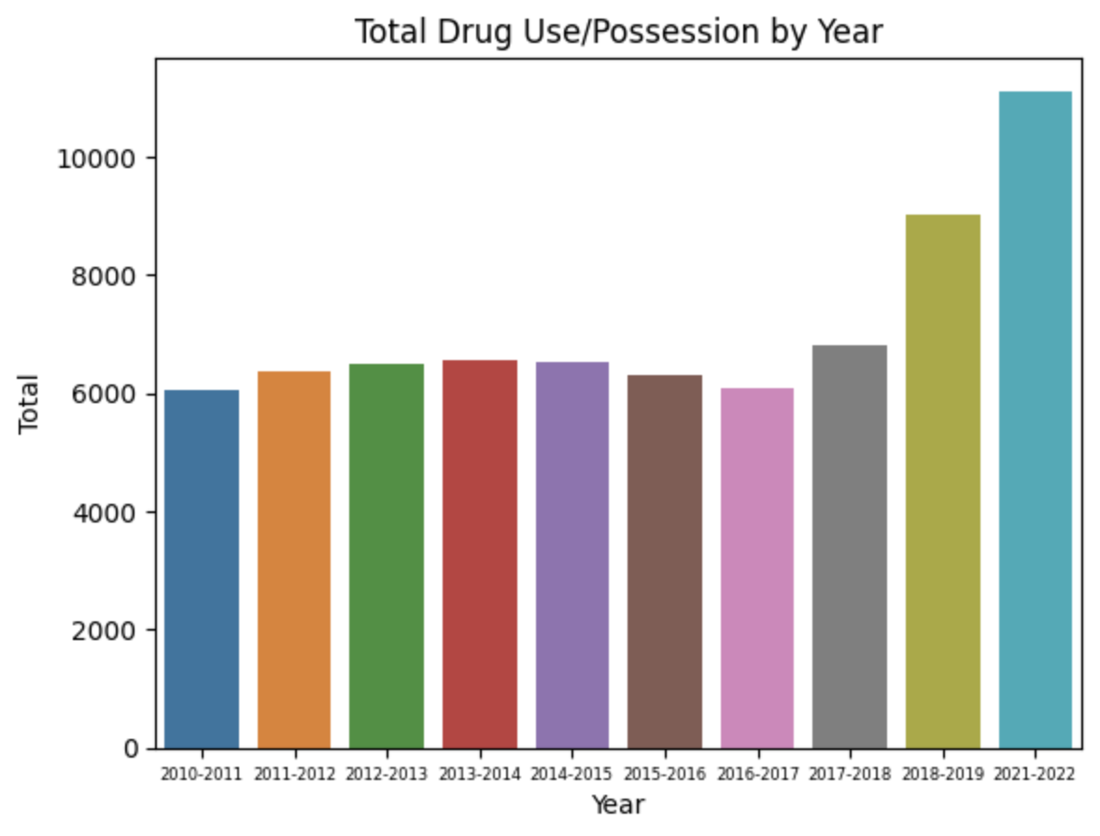
Drug Use and Possession on Campus
Florida Public Schools saw a 23% increase in drug use and drug possession after the 2020-2021 school year.
“The use or possession of any drug, narcotic, controlled substance, or any substance when used for chemical intoxication.”

Slide 20
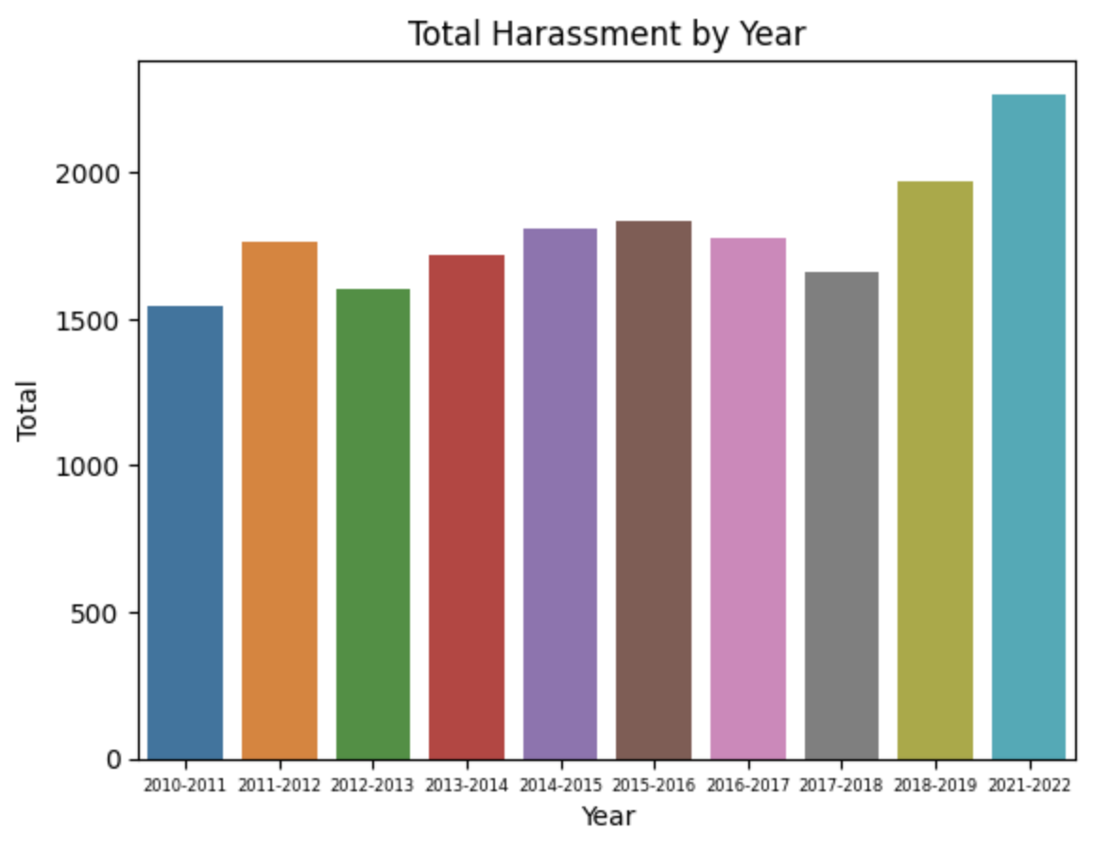
Harassment by Year
Following lockdown, harassment reports in public schools in Florida increased by 15%.
“Any threatening, insulting, or dehumanizing gesture, use of data or computer software, or written, verbal, or physical conduct that places a student or school employee in reasonable fear of harm to his or her person or damage to his or her property, has the effect of substantially interfering with a student’s educational performance, opportunities, or benefits, or has the effect of substantially disrupting the orderly operation of a school including any course of conduct directed at a specific person that causes substantial emotional distress in such a person and serves no legitimate purpose. Instances of Harassment that are chronic or repeated in nature should be evaluated for Bullying or Bullying-related.”

Slide 21
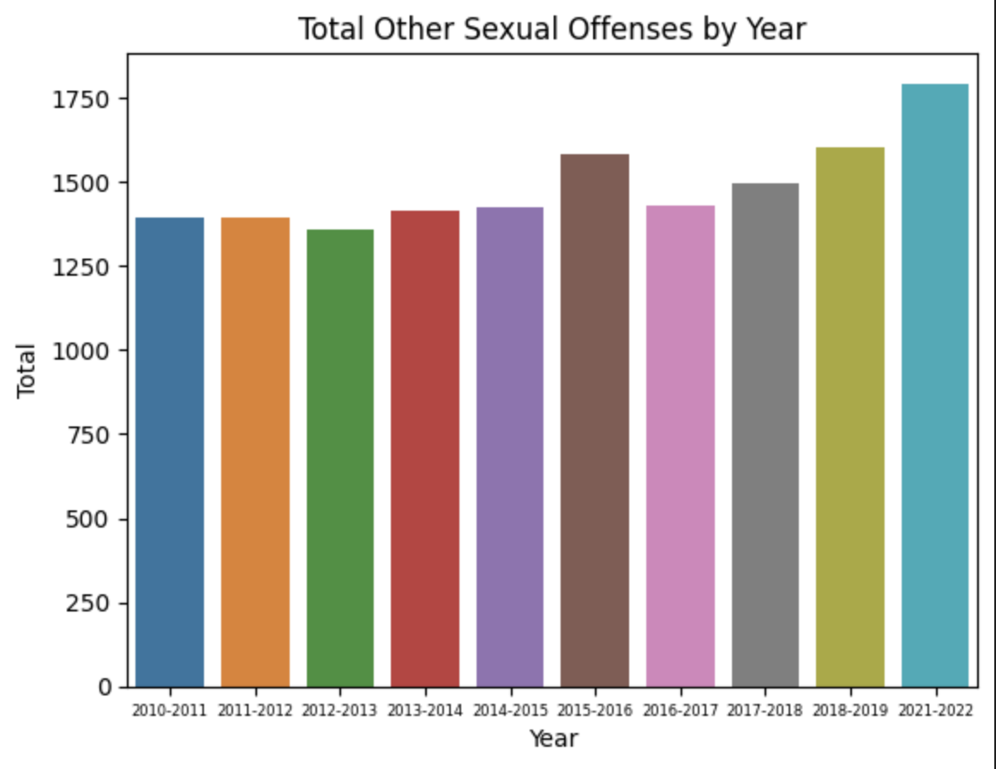
Other Sexual Offenses
Other Sexual Offenses increased by 12% following the 2020-2021 school year.
“Other sexual contact, including intercourse, without force or threat of force. Subjecting an individual to lewd sexual gestures, sexual activity, or exposing private body parts in a lewd manner.”

Slide 22
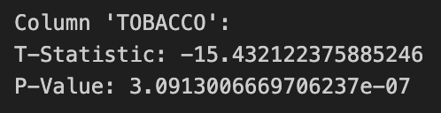
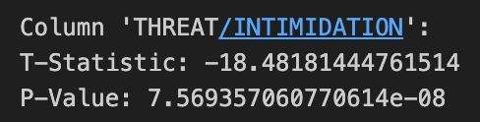
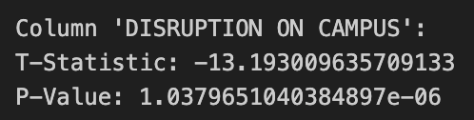
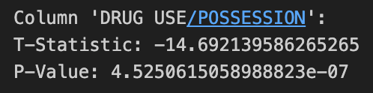
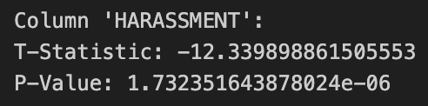
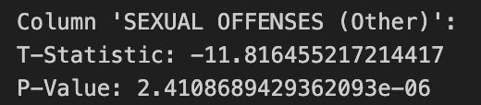
Test Statistics and P-Values
When analyzing the data, the six most pronounced test statistics were the six categories detailed previously.

Slide 23
Following the analysis of these six categories, I then investigated general violence in public schools and looked to see if students overall are more violent following the Covid-19 lockdowns.
I created a single dataframe composed of the four primary categories of violence:
Battery
Fighting
Physical Attach
Sexual Assault
Investigating Violence

Slide 24
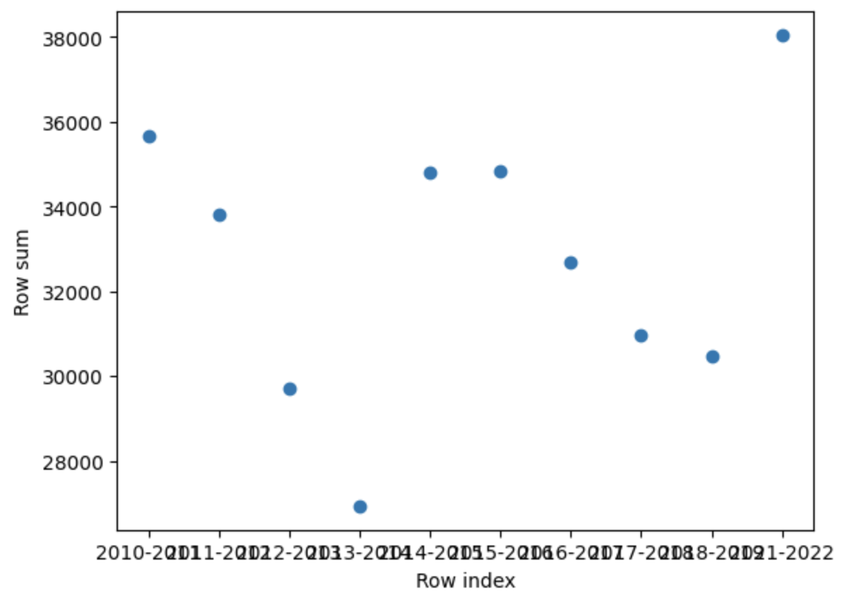
Violent Behavior Results
As you can see, the scatterplot of the total violent behavior reports across Florida public schools has no linear regression and lacks a predictable manner.

Slide 25
Conclusions
When analyzing several categories, the six primary categories that contributed the most to the 30% in discipline incidences are
Disruption on Campus, Drug Use/Possession, Harassment, Other Sexual Offenses, Threat/Intimidation, and Tobacco Use
All six of these categories point to an inner turmoil and mental health crisis amongst Florida public school students.

Slide 26
Appendix
https://github.com/njohnsonlovesmath/Covid-Discipline-Analysis

